Slide 1
Tugas Database Group By
Muhammad Ryan Handhika Susanto

Slide 2
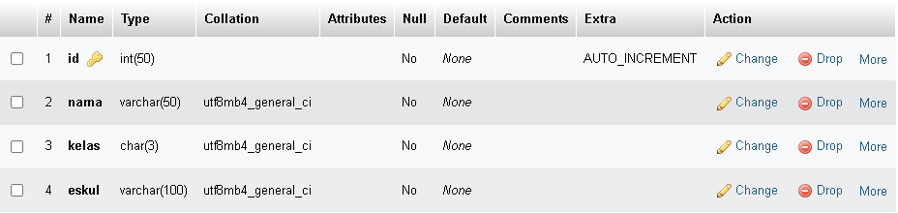
Struktur Tabel

Slide 3

Struktur Database

Slide 4
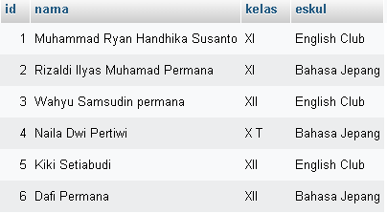
Data

Slide 5

Syntax SQL

Slide 6
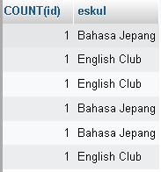
Hasil

